Slide 1

Network Monitoring And Suspicious
Traffic Detection
Name : Jeevitha R
Course : B.E.CSE(CYBER SECURITY)
Internship : Skillentrix Internship
Date : 26/03/2026

Slide 2
ABSTRACT
• This project focuses on monitoring network traffic and detecting
suspicious activities using packet analysis tools. Wireshark is
used to capture and analyze packets, while Python with Scapy is
used to perform real-time monitoring. The system identifies
unusual patterns such as repeated traffic from a single IP and
external connections.

Slide 3
AIM :
To capture and analyze different network protocols such as TCP, UDP, DNS,
and HTTP using Wireshark.
TOOLS USED :
*Wireshark software
*Internet connection
*Computer/Laptop

Slide 4
Network Capture Packets
The network traffic was captured using Wireshark on a Wi-Fi
network. The capture was performed for a duration of
approximately 10–15 minutes while performing normal internet
activities such as browsing websites and using online applications.
After capturing, filters were applied to analyze specific types of
traffic such as DNS and TCP.

Slide 5
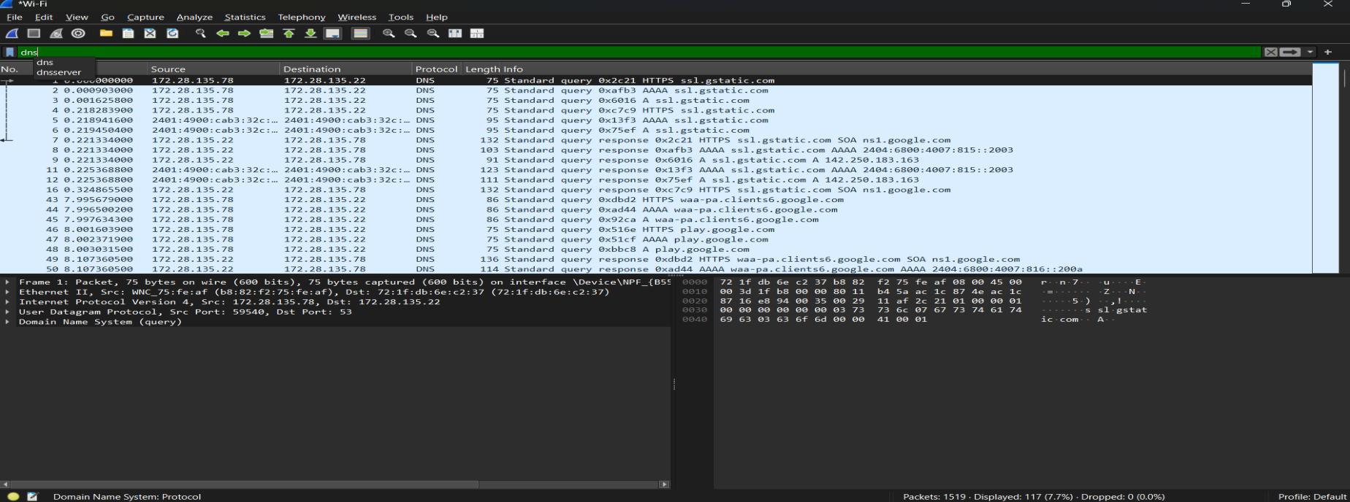
SCREENSHOT OF PACKET CAPTURE
1. DNS Protocol
The screenshot shows DNS packets captured using Wireshark. DNS (Domain Name System) is used to
translate domain names into IP addresses, allowing communication between devices on a network.

Slide 6
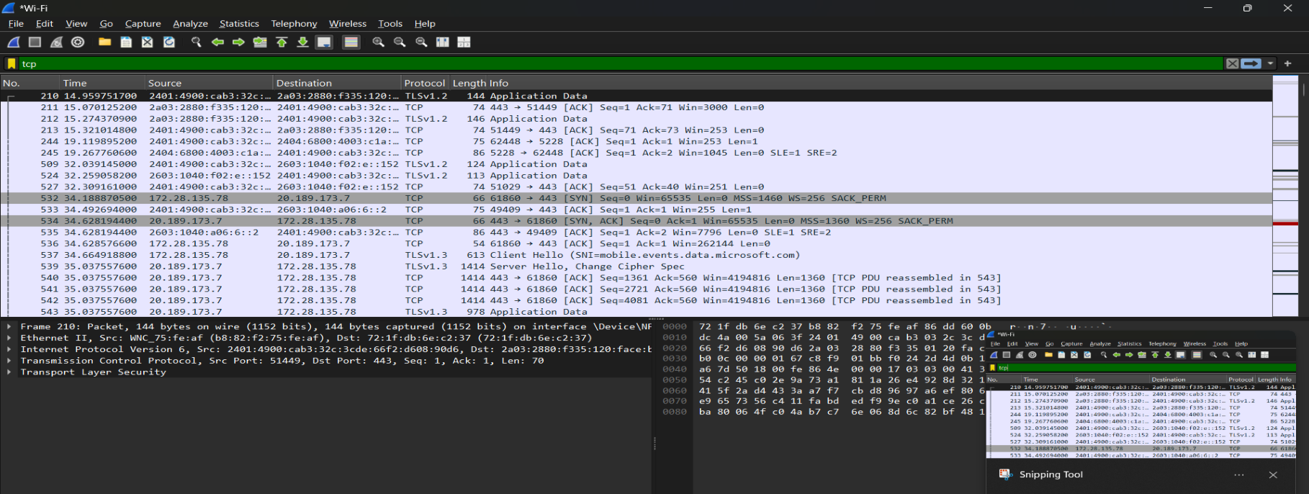
2. TCP Protocol
The screenshot shows TCP packets captured using Wireshark. The communication follows the TCP three-way
handshake process (SYN, SYN-ACK, ACK), which is used to establish a reliable connection between the client and the
server. This ensures reliable data transmission and indicates normal network communication.

Slide 7
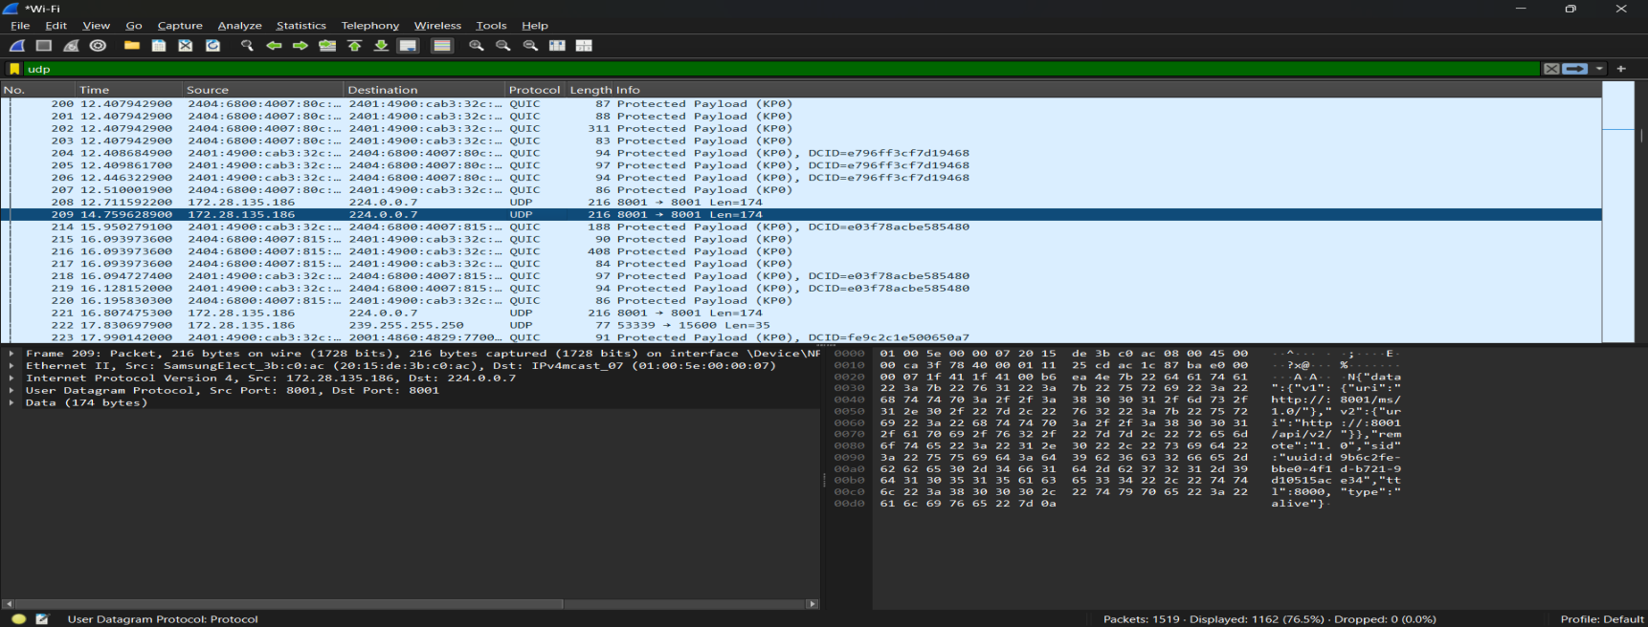
3. UDP Protocol
The screenshot shows UDP packets captured using Wireshark. UDP (User Datagram Protocol) is a connectionless
protocol that sends data without establishing a connection. It is faster but less reliable, as it does not use
acknowledgments or retransmission.

Slide 8
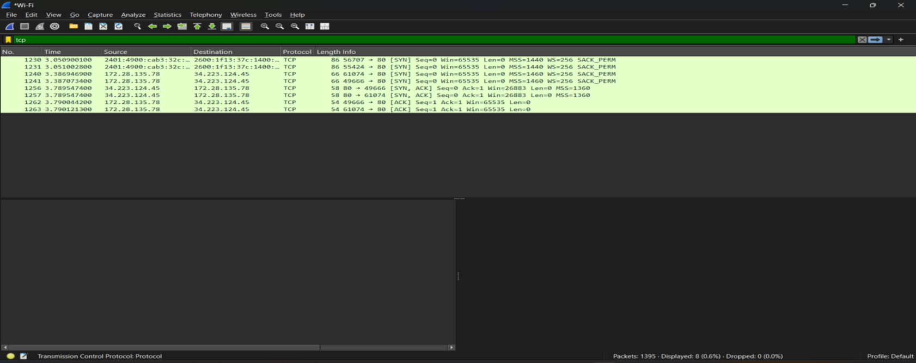
4. HTTP Protocol
The screenshot shows HTTP packets captured using Wireshark. HTTP (HyperText Transfer Protocol) is used for
communication between a web browser and a web server. It works on port 80 and follows a request-response model
where the client sends a GET request and the server responds with data.

Slide 9
Suspicious Traffic Analysis :
During the analysis of captured packets, several observations were made:
• Multiple DNS queries were observed for domains such as google.com, ssl.gstatic.com, and
play.google.com, indicating normal browsing activity.
• Repeated DNS requests to the same domains were detected, showing continuous background
communication by applications.
• TCP retransmissions were identified, suggesting possible packet loss or network delay.
• A large amount of TLS-encrypted traffic over port 443 was observed, representing secure
communication that could not be deeply inspected.
• Multicast DNS (mDNS) traffic indicated the presence of local network devices.
• Although no clearly malicious traffic was detected, the presence of retransmissions and repeated
DNS queries highlights the importance of continuous monitoring.

Slide 10
CONCLUSION
• This experiment helped in understanding how different network
protocols work in real-time. TCP provides reliable communication,
UDP offers faster transmission without reliability, DNS resolves
domain names, and HTTP enables web communication between
client and server.

Slide 11
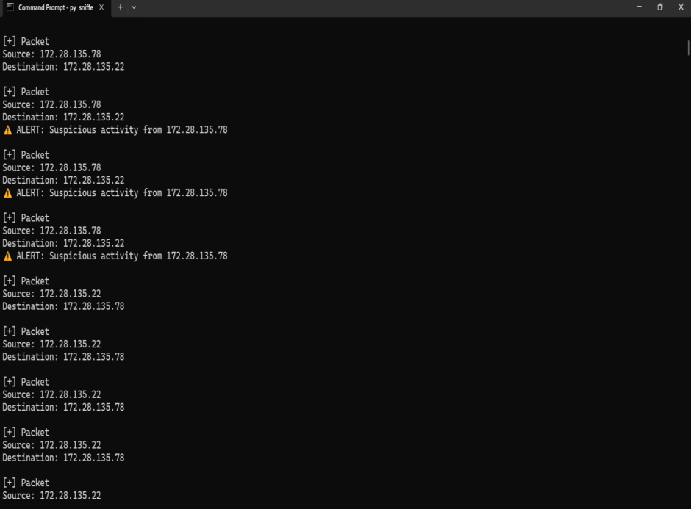
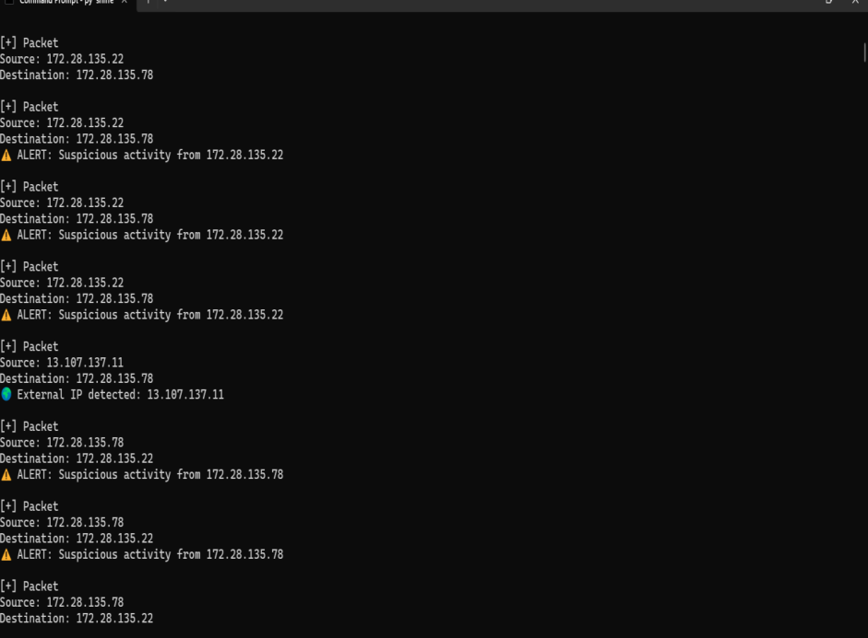
Packet Analysis output :
From the output, we can observe different source and destination IP addresses. The protocol field shows TCP/UDP
communication. Some multicast addresses were also observed, which are part of normal network activity.

